Slide 1
Markov-Driven Graph Convolutional Networks for Social Spammer Detection
Paper Review
Md Minhazul Islam Rimon
ID: 20101078
Course: CSE438
Section:1

Slide 2
Topics
Introduction
Suggested Improvement
Dataset
Compare Against Other Approaches
Results
Performance
Future Work

Slide 3
Introduction
Social Network
Spammer
What a spammer do
Why their existence is important
Current methods

Slide 4
Suggested Improvement
Node2Vec, Doc2Vec and user-symbol network
Markov Random Field (MRF)
GCNwithMRF, Graph Convolution Network (GCN)
Markov-driven Graph Convolution Network (MDGCN)

Slide 5
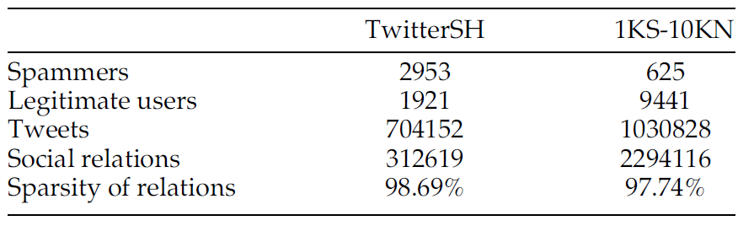
Dataset
Twitter Dataset
Twitter Social Honeypot Dataset (TwitterSH)
Twitter 1KS-10KN Dataset
Fig 1: Statistics of Processed Datasets

Slide 6
Compare Against Other Approaches
SMFSR
OSSD
SybilBelief
SybilSCAR
GANG
RF
GCN
GCNsg
CARE-GNN
GIN
DCI

Slide 7
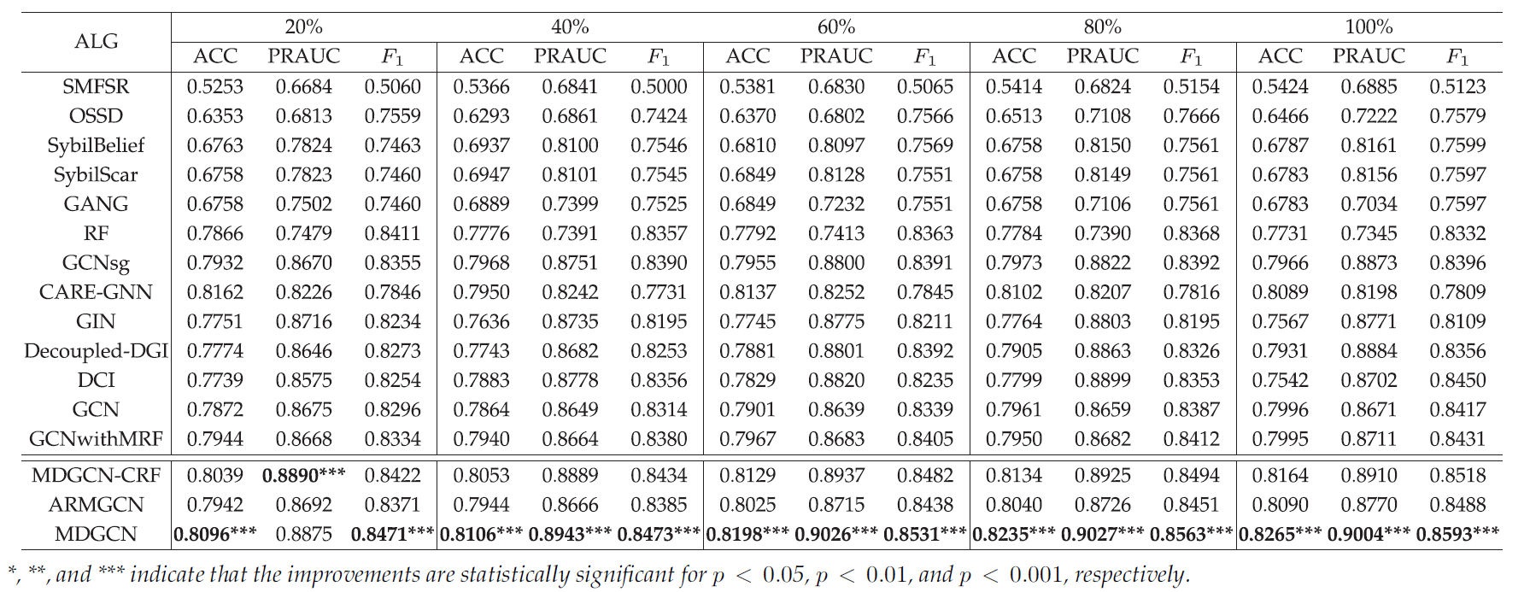
Results
Fig 2: Comparison Results on TwitterSH Dataset

Slide 8
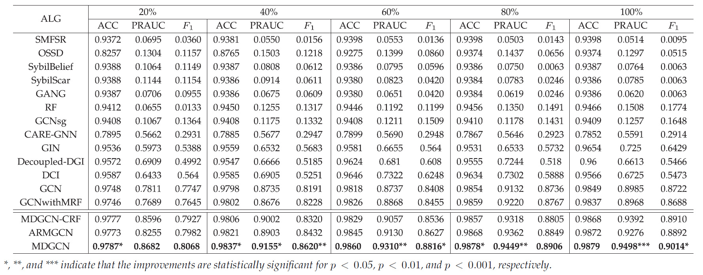
Results
Fig 3: Comparison Results on 1KS-10KN Dataset

Slide 9
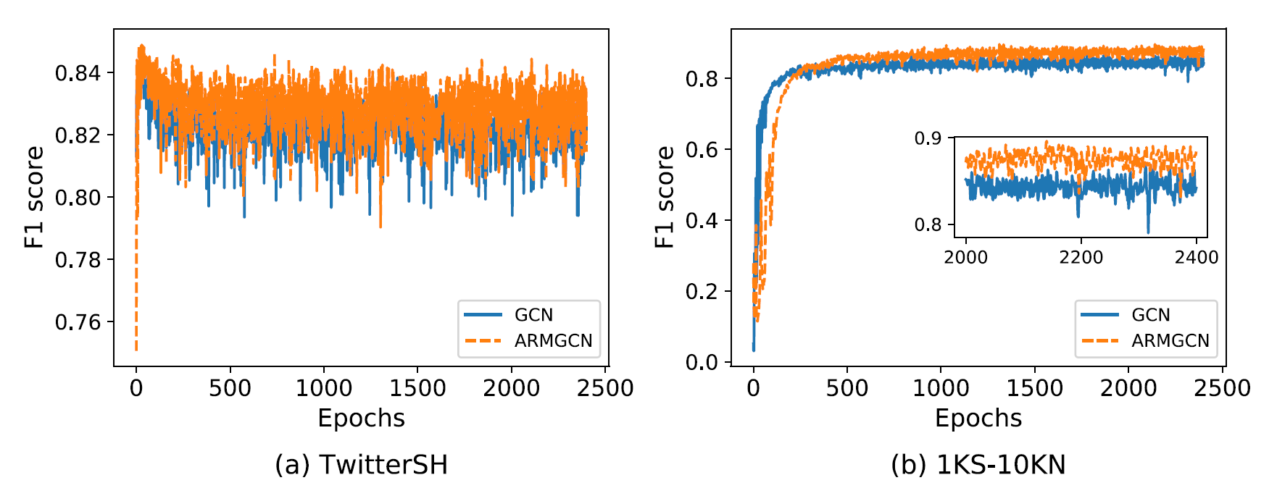
Performance
Fig 4: The change curve of F1 score of GCN and ARMGCN with the progress of training.

Slide 10
Future Work
Add other methods for handling output from one to another model
Feature analysis
Other algorithm combinations

